Slide 1
Countries of the World
December 24, 2018

Slide 2
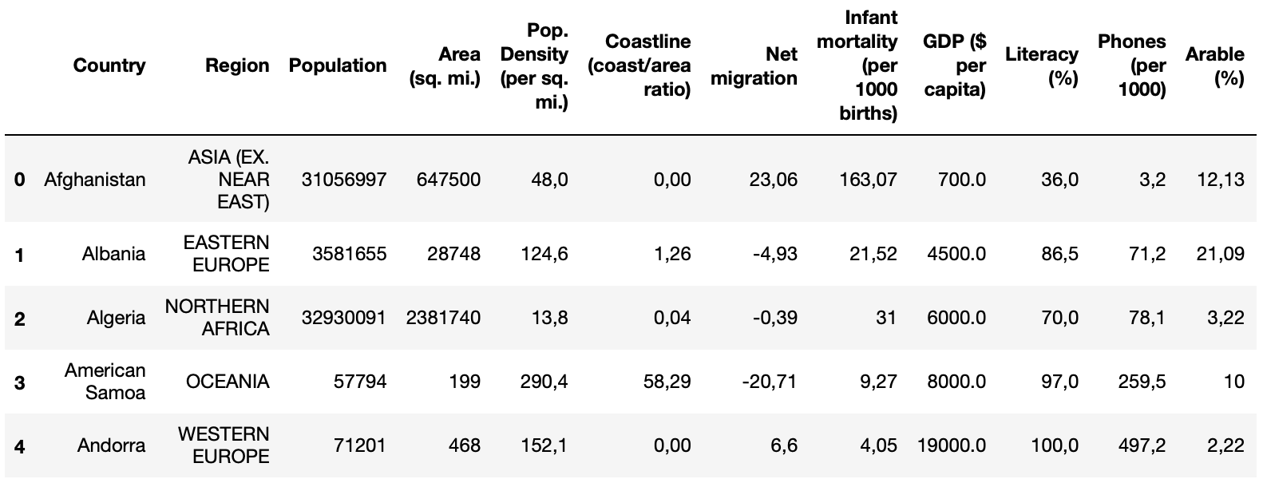
Dataset: 227 countries, 20 features
Country names linked to region, population, area size, GDP, mortality and more
countries of the world.csv (37.41 KB): Data compiled from US Government (1970-2017)
https://www.kaggle.com/fernandol/countries-of-the-world

Slide 3
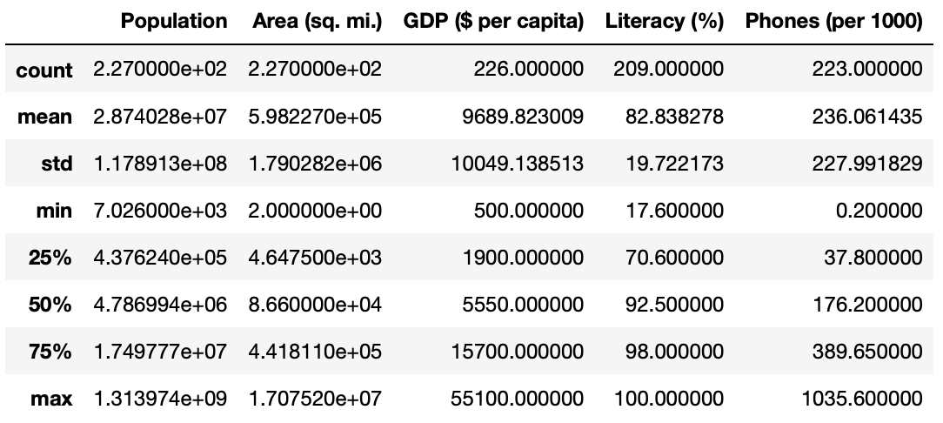
Observation on phone penetration

Slide 4
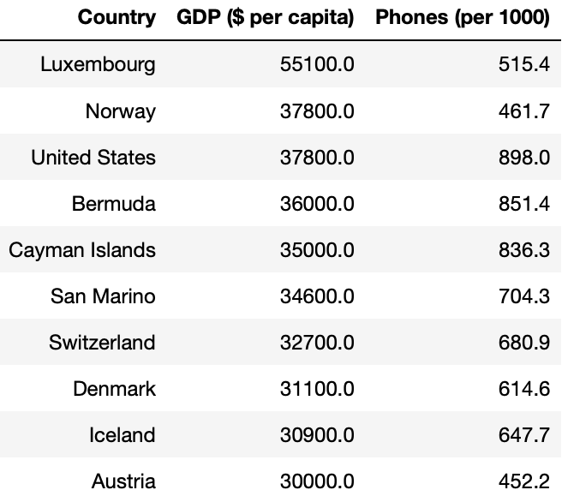
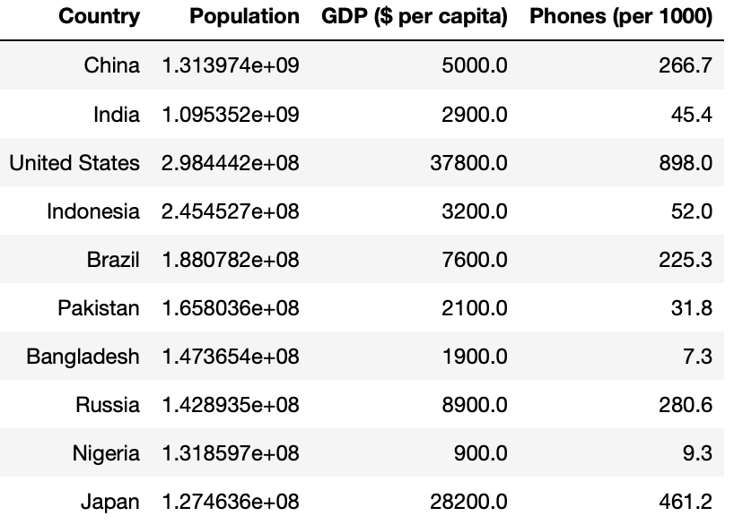
Top-10 from different perspectives

Slide 5
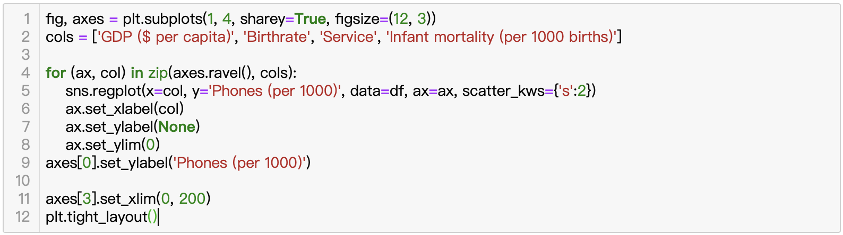
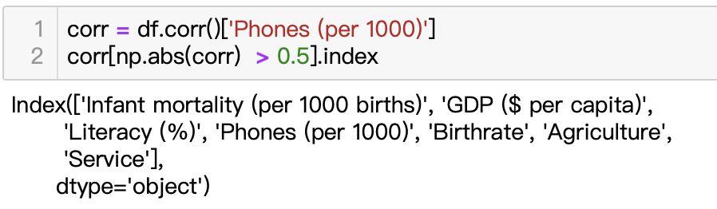
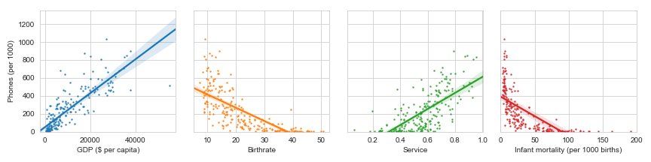
What features affect phone penetration?

Slide 6
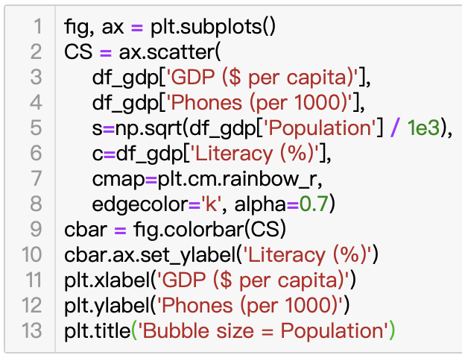
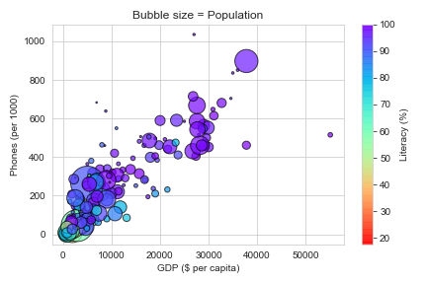
What features affect phone penetration?
Top-3 positively correlated features
GDP ($ per capita) 0.834499
Service 0.683934
Literacy (%) 0.601935
Top-3 negatively correlated features
Birthrate -0.724614
Infant mortality (per 1000 births) -0.672312
Agriculture -0.601739

Slide 7
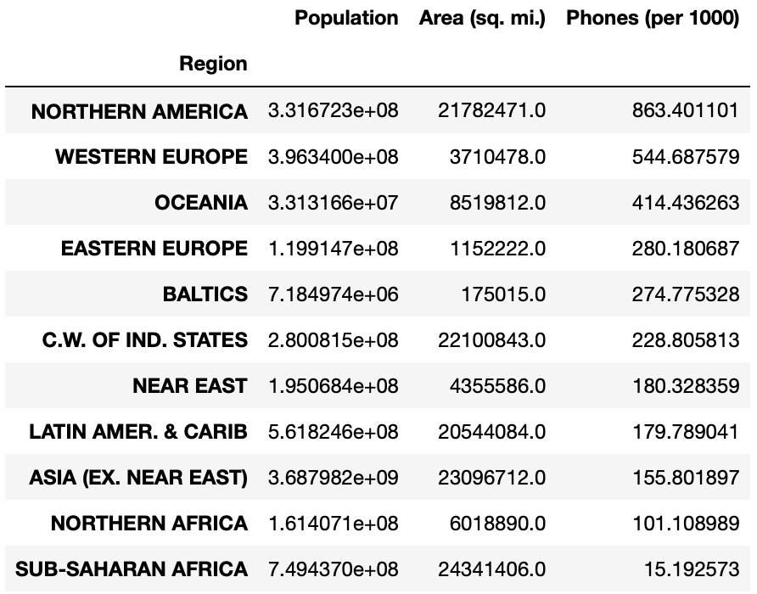
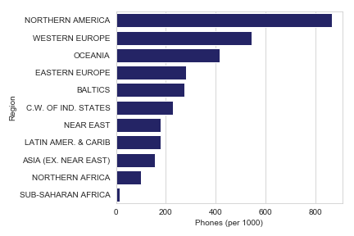
pandas.DataFrame.groupby(‘Region’)

Slide 8
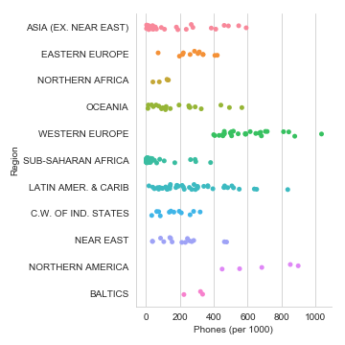
sns.catplot()

